Slide 1



Sourav Das
06-03-2022

Slide 2



Outline
Executive Summary
Introduction
Methodology
Results
Conclusion
Appendix

Slide 3
Executive Summary
Summary of methodologies
Data Collection
Data Wrangling
EDA with Data Visualization
EDA with SQL
Building an interactive map with Folium
Predictive Analysis (Classification)
Summary of all results
Exploratory data analysis result
Interactive analysis demo using screenshots
Predictive Analysis Results

Slide 4
Introduction
Project background and context
We will predict if the Falcon 9 first stage will land successfully. SpaceX advertises Falcon 9 rocket launches on its website, with a cost of 62 million dollars; other providers cost upward of 165 million dollars each, much of the savings is because SpaceX can reuse the first stage. Therefore if we can determine if the first stage will land, we can determine the cost of a launch. This information can be used if an alternate company wants to bid against SpaceX for a rocket launch. In this module, you will be provided with an overview of the problem and the tools you need to complete the course.
Problems that needed solving
What influences if the rocket will land successfully ?
The effect each relationship with certain rocket variables will impact in determining the success rate of a successful landing .
What conditions do SpaceX have to achieve to get the best results and ensure the best rocket success landing rate .

Slide 5


Slide 6
Methodology
Data collection methodology:
SpaceX Rest API
Web Scrapping from Wikipedia
Perform data wrangling
One Hot Encoding data fields for Machine Learning and dropping irrelevant columns
Perform exploratory data analysis (EDA) using visualization and SQL
Plotting Scatter Graphs, Bar Graphs to show relationship between variables and patterns of data
Perform interactive visual analytics using Folium and Plotly Dash
Perform predictive analysis using classification models
How to build, tune, evaluate classification models

Slide 7
Data Collection
Collection of Datasets was done by following
Worked with SpaceX launch data that is gathered from the SpaceX Rest API.
The API gave the data about launches, including information about the rocket used, payload delivered, launch specifications and landing outcome.
The goal is to use this data to predict whether SpaceX will attempt to land a rocket or not.
The SpaceX Rest API endpoints or URL starts with api.spacexdata.com/v4/.
Another popular data source for obtaining Falcon 9 launch data is web scrapping Wikipedia using BeautifulSoup.
SpaceX REST API
Web Scrapping
Use SpaceX REST API
API returns SpaceX Data in JSON
Normalize data into flat data file such as .csv
Get HTML Response from Wikipedia
Extract data using Beautiful Soup
Normalize data into flat data file such as .csv

Slide 8
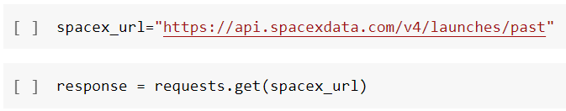
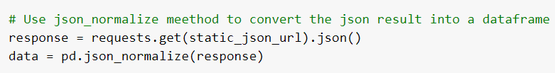
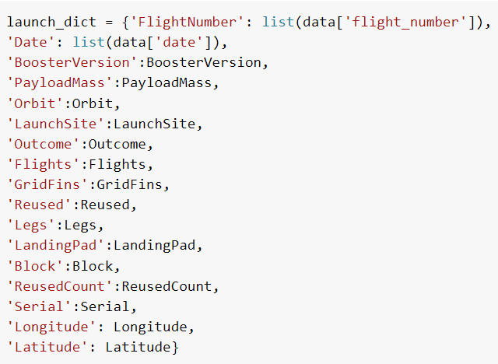
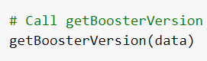
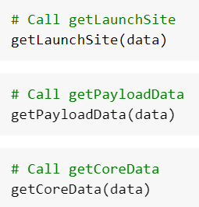

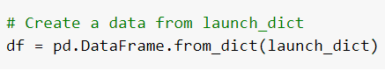
Data Collection – SpaceX API
1. Getting response from API
2. Converting response to a JSON File
4. Assign list to Dictionary then Data Frame
3. Apply custom functions to clean data
5. Filter Data Frame and export to flat file (.csv)

Slide 9
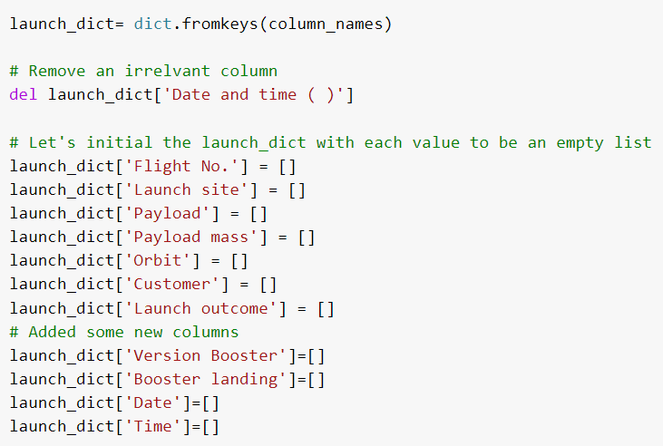
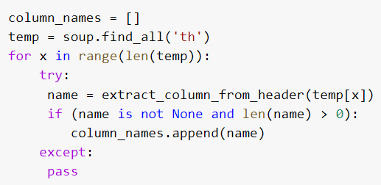
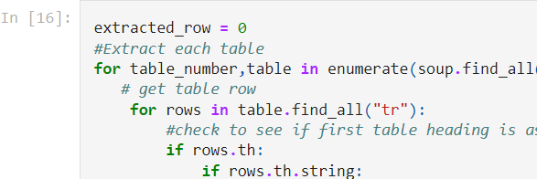
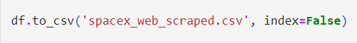
Data Collection - Scraping
1. Getting response from HTML
2. Creating BeautifulSoup object
5. Creation of Dictionary
3. Finding Tables
4. Getting Column Names
6. Appending Data to Keys (refer to notebook Block 16)
7. Converting Dictionary to Data Frame
8. Export to flat file (.csv)

Slide 10
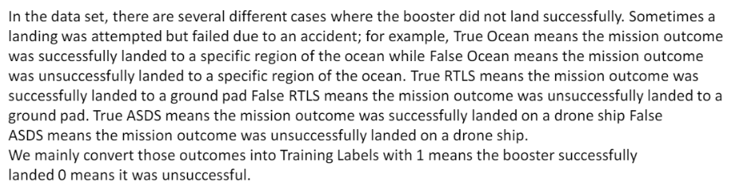

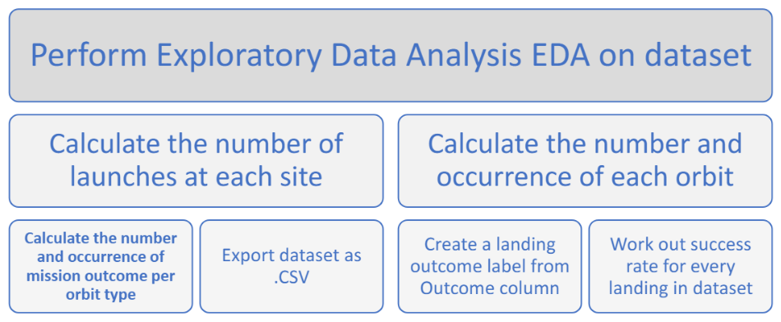
Data Wrangling
Introduction
Each launch aims to an dedicated orbit, and here are some common orbit types:
Process
Diagram showing common
orbit types SpaceX uses

Slide 11


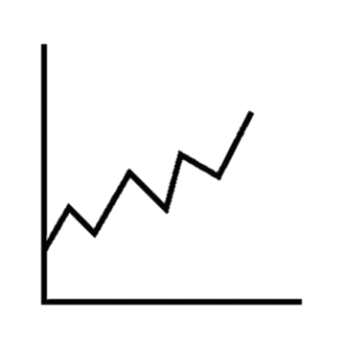
EDA with Data Visualization
Scatter Graphs being drawn
Flight Number vs. Payload Mass
Flight Number vs. Launch Site
Payload vs. Launch Site
Orbit vs. Flight Number
Payload vs. Orbit Type
Orbit vs. Payload Mass
Bar Graph being drawn
Mean vs. Orbit
A bar diagram makes it easy to compare sets of data between different groups at a glance. The graph represents categories on one axis and a distance value in the order. The goal is to show the relationship between the two axes. Bar charts can also show big changes in data over time.
Line Graph being drawn
Success Rate vs. Year
Scatter plots show how much one variable is affected by another. The relationship between two variables are called their correlation. Scatter plots usually consists of large body of data.
Line graphs are useful in that they show data variables and trends very clearly and can help to make predictions about the results of data not yet recorded.

Slide 12
EDA with SQL
Performed SQL queries to gather information about the dataset
For example of some questions we were asked about the data we needed information about. Which we are using SQL queries to get the answers in the dataset:
Displaying the names of the unique launch sites in the space mission
Displaying 5 records where launch sites begin with the string ‘KSC’
Displaying the total payload mass carried by boosters launched by NASA (CRS)
Displaying average payload mass carried by booster version F9 v1.1
Listing the date where the successful landing outcome in drone ship was achieved.
Listing the names of the boosters which have success in ground pad and have payload mass greater than 4000 but less than 6000
Listing the total number of successful and failure mission outcomes
Listing the names of the booster_versions which have carried the maximum payload mass.
Listing the records which will display the month names, successful landing_outcomes in ground pad ,booster versions, launch_site for the months in year 2017
Ranking the count of successful landing_outcomes between the date 2010-06-04 and 2017-03-20 in descending order.

Slide 13
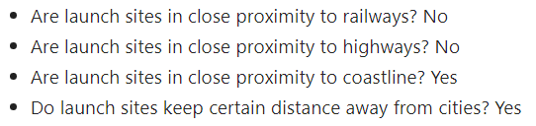
Build an Interactive Map with Folium
To visualize the Launch Data into an interactive map. We took the Latitude and Longitude Coordinates at each launch site and added a Circle Marker around each launch site with a label of the name of the launch site.
We assigned the dataframe launch_outcomes(failures, successes) to classes 0 and 1 with Green and Red markers on the map in a MarkerCluster()
Using Haversine's formula we calculated the distance from the Launch Site to various landmarks to find various trends about what is around the Launch Site to measure patterns. Lines are drawn on the map to measure distance to landmarks.

Slide 14
Build a Dashboard with Plotly Dash
The dashboard is built with Flask and Dash web framework.
Graphs:
Pie Chart showing the total launches by a certain site/all sites
Display relative proportions of multiple classes of data.
Size of the circle can be made proportional to the total quantity it represents.
Scatter Graph showing the relationship with Outcome and Payload Mass (Kg) for the different Booster Versions :
It shows the relationship between two variables.
It is the best method to show you a non-linear pattern.
The range of data flow, i.e. maximum and minimum value, can be determined.
Observation and reading are straightforward.

Slide 15
Predictive Analysis (Classification)
1. BUILDING MODEL
Load our dataset into NumPy and Pandas Transform Data
Split our data into training and test data sets
Check how many test samples we have
Decide which type of machine learning algorithms we want to use
Set our parameters and algorithms to GridSearchCV
Fit our datasets into the GridSearchCV objects and train our dataset.
2. EVALUATING MODEL
Check accuracy for each model
Get tuned hyperparameters for each type of algorithms
Plot Confusion Matrix
3. IMPROVING MODEL
Feature Engineering
Algorithm Tuning
4. FINDING THE BEST PERFORMING CLASSIFICATION MODEL
The model with the best accuracy score wins the best performing model
In the notebook there is a dictionary of algorithms with scores at the bottom of the notebook.

Slide 16
Results
Exploratory data analysis results
Interactive analytics demo in screenshots
Predictive analysis results

Slide 17

Section 2

Slide 18
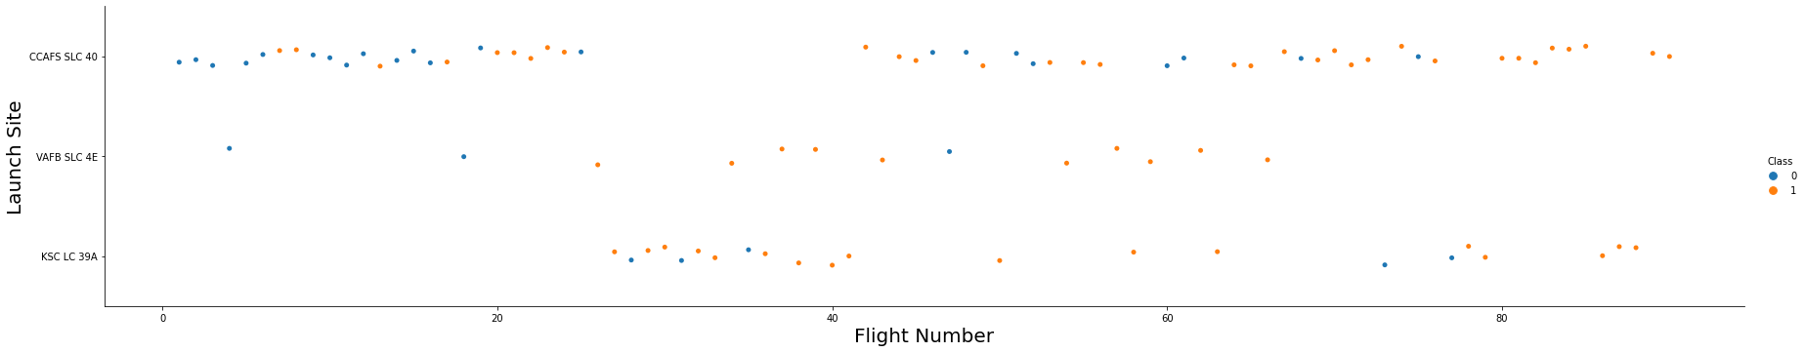
Flight Number vs. Launch Site
The more amount of flights at a launch site the greater the success rate at a launch site

Slide 19
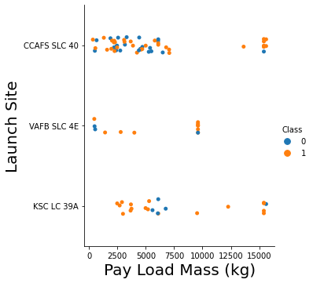
Payload vs. Launch Site
The greater the payload mass for Launch Site CCAFS SLC 40 the higher the success rate for the Rocket. There is not quite a clear pattern to be found using this visualization to make a decision if the Launch Site is dependent on Pay Load Mass for a success launch.

Slide 20
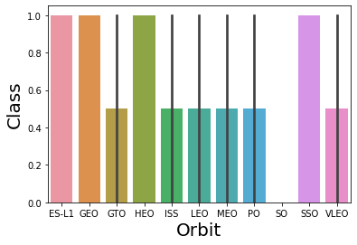
Success Rate vs. Orbit Type
Orbit ES-L1, GEO, HEO and SSO has the highest success rate and orbit SO has the lowest success rate.

Slide 21
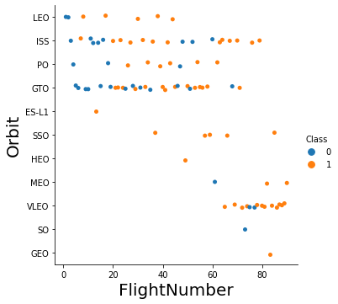
Flight Number vs. Orbit Type
In the LEO orbit the success related to the number of flights. On the other hand, there seems to be no relationship between flight number when in GTO orbit.

Slide 22
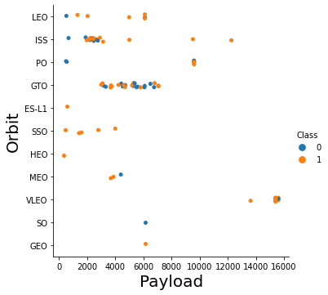
Payload vs. Orbit Type
With heavy payloads the successful landing or positive landing rate are more for Polar, LEO and ISS.
However for GTO we cannot distinguish this well as both positive landing rate and negative landing(unsuccessful mission) are both there here.

Slide 23
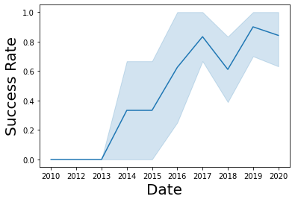
Launch Success Yearly Trend
It can be observed that the success rate since 2013 kept increasing till 2020.

Slide 24
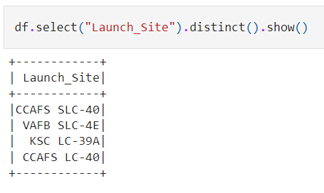
All Launch Site Names
SQL Query
Query Explanation:
Using distinct() function in the query means that it will only show unique values in the Launch_Site

Slide 25
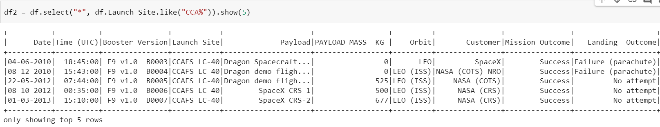
Launch Site Names Begin with 'CCA'
SQL Query
Query Explanation:
Using the ‘show(5)’ in the query means that it will only show top 5 records and ‘like’ function has a wild card with the words ‘CCA%' the percentage in the end suggests that the Launch Site name must start with CCA.

Slide 26
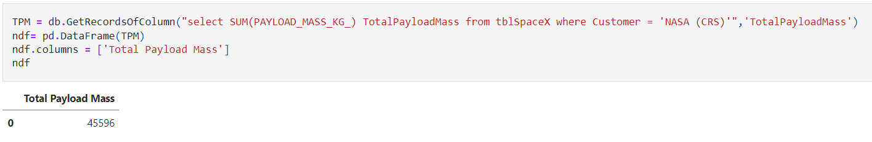
Total Payload Mass
SQL Query
Query Explanation:
Using the function SUM summates the total in the column PAYLOAD_MASS_KG_.
The WHERE clause filters the dataset to only perform calculations on Customer NASA (CRS).

Slide 27
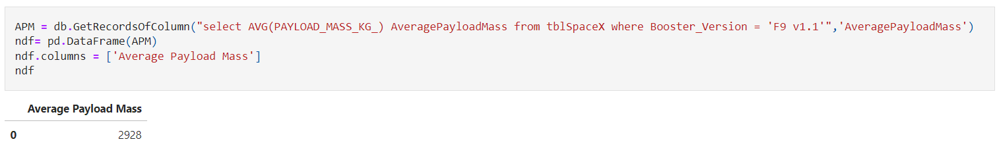
Average Payload Mass by F9 v1.1
SQL Query
Query Explanation:
Using the function AVG works out the average in the column PAYLOAD_MASS_KG_.
The WHERE clause filters the dataset to only perform calculations on Booster_Version F9 v1.1.

Slide 28
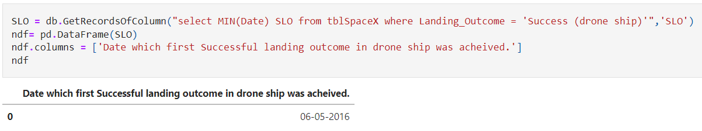
First Successful Ground Landing Date
SQL Query
Query Explanation:
Using the function MIN works out the minimum date in the column Date.
The WHERE clause filters the dataset to only perform calculations on Landing_outcome Success (drone ship).

Slide 29
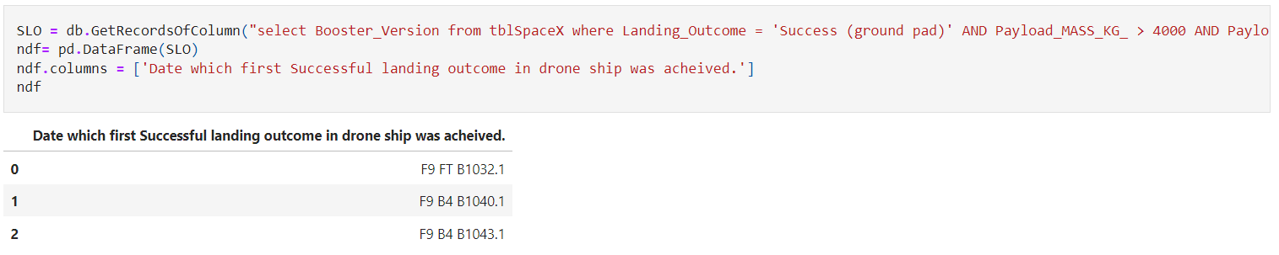
Successful Drone Ship Landing with Payload between 4000 and 6000
SQL Query
Query Explanation:
The WHERE clause filters the dataset to only perform calculations on Landing_outcome Success (drone ship).
The AND clause specifies additional filter conditions Payload_MASS_KG_ > 4000 AND Payload_MASS_KG_ < 6000.

Slide 30
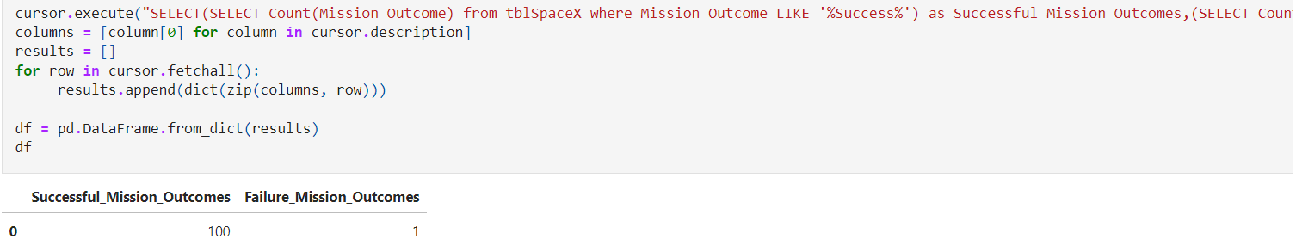
Total Number of Successful and Failure Mission Outcomes
SQL Query
Query Explanation:
We used subqueries here to produce the results. The LIKE '%f00%' wildcard shows that in the record the foo phrase is in any part of the string in the records for example.
PHRASE "(Drone Ship was a Success)" LIKE '%Success%' Word 'Success' is in the phrase the filter will include it in the dataset.

Slide 31
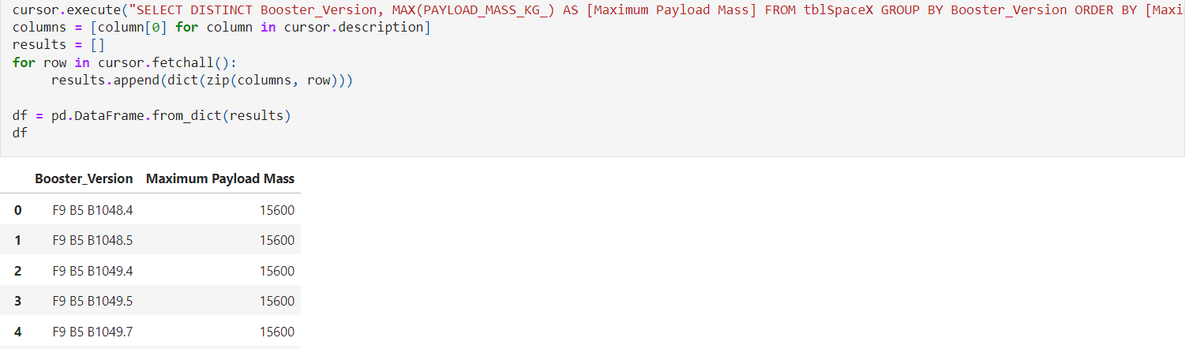
Boosters Carried Maximum Payload
SQL Query
Query Explanation:
Using the word DISTINCT in the query means that it will only show Unique values in the Booster Version column. GROUP BY puts the list in order set to a certain condition. DESC means its arranging the dataset into descending order.

Slide 32
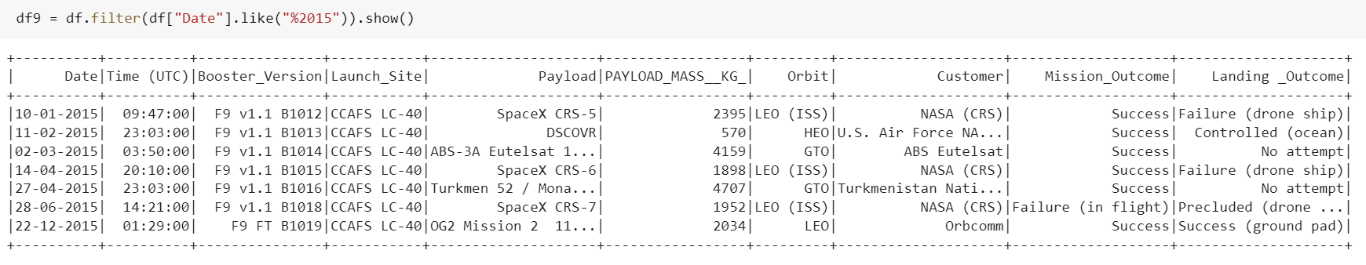
2015 Launch Records
SQL Query
Query Explanation:
The filter() function filters rows from the data frame.
The ‘like’ function has a wild card with the words ‘%2015' the percentage in the first suggests that the Date must end with 2015.

Slide 33
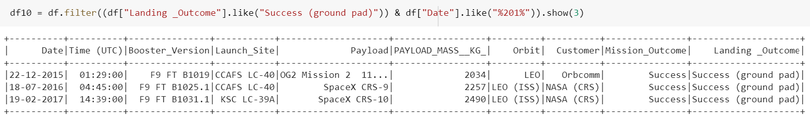
Rank Landing Outcomes Between 2010-06-04 and 2017-03-20
SQL Query
Query Explanation:
The filter() function filters rows from the data frame.
The ‘like’ function has a wild card with the words.
The show() function shows the exact result.

Slide 34

Section 3

Slide 35
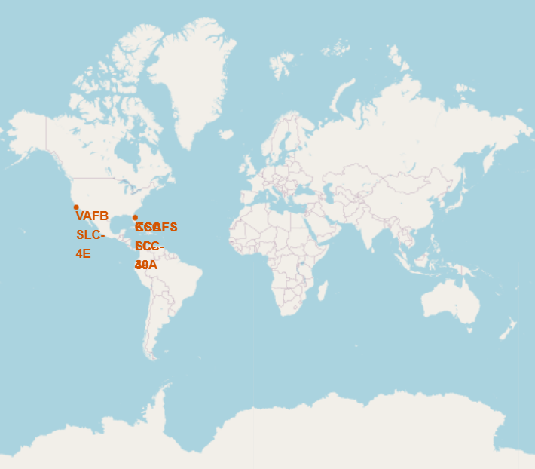
Launch Sites of SpaceX From Global Map
We can see that the SpaceX launch sites are in the United States of America coasts. Florida and California.
We also see that all the launch sites are not closer to Equator line but very close to the coast area.

Slide 36
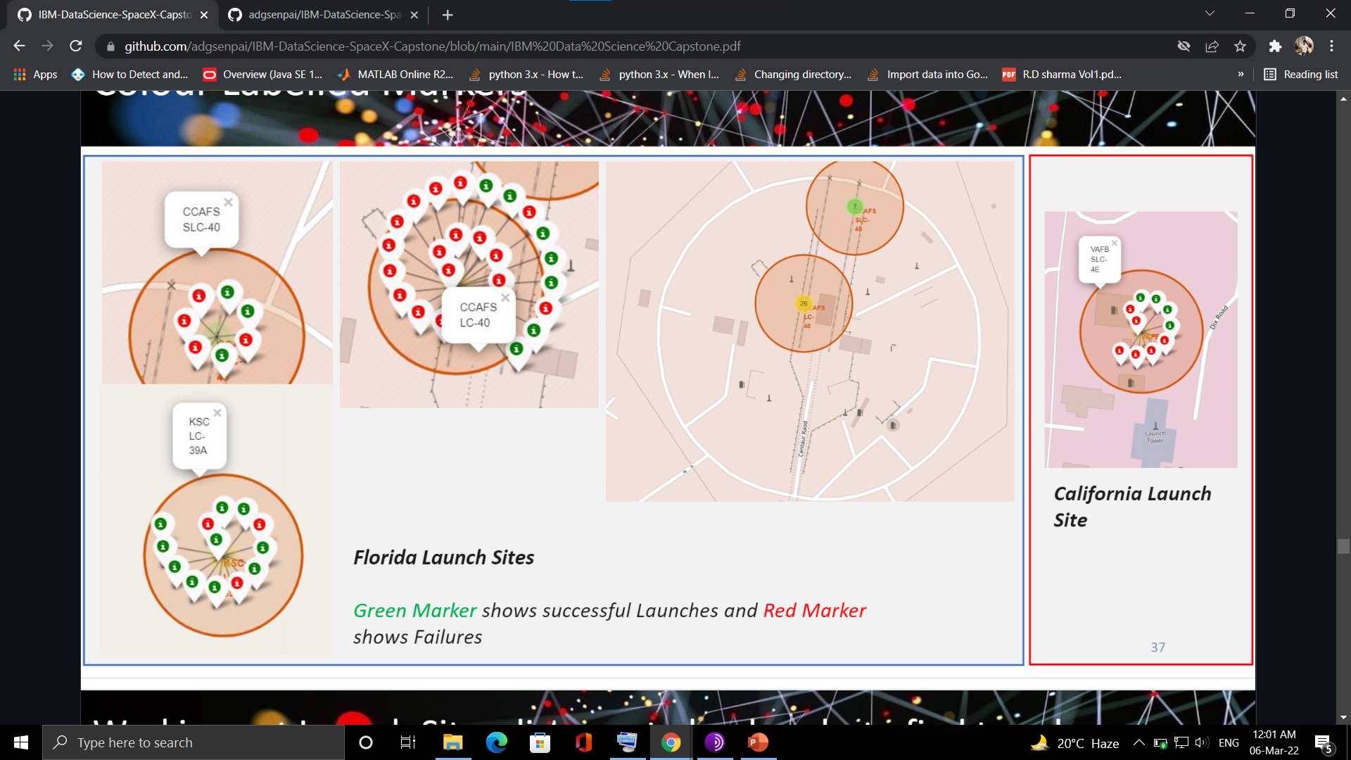
Color Labelled Markers
California Launch Site
Green Marker shows successful launches and Red Marker shows failure.
Florida Launch Sites

Slide 37
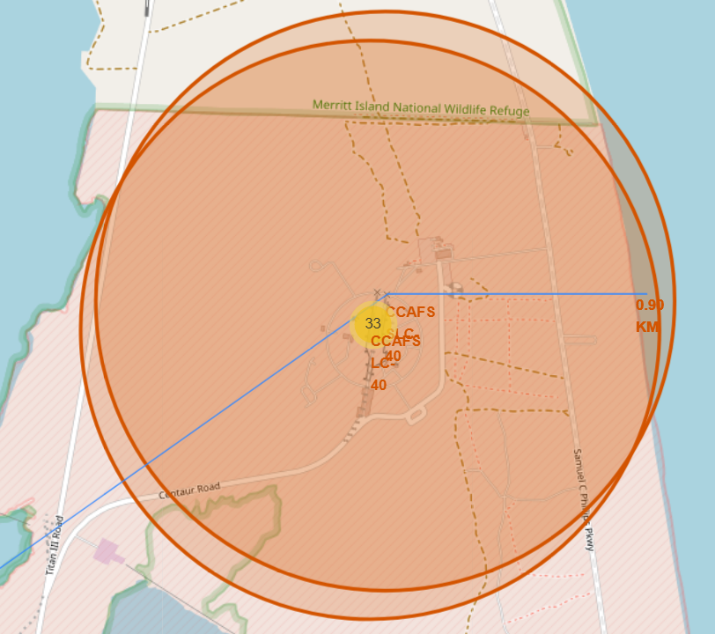
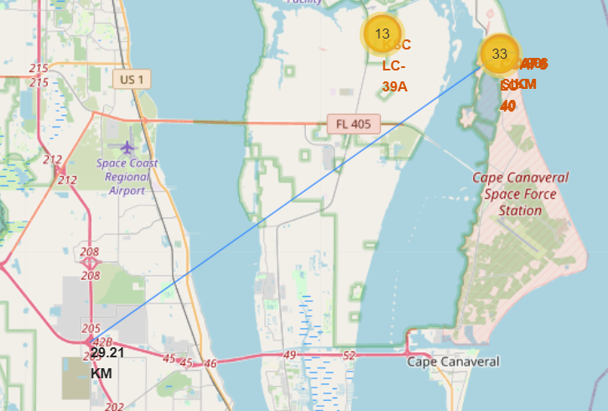
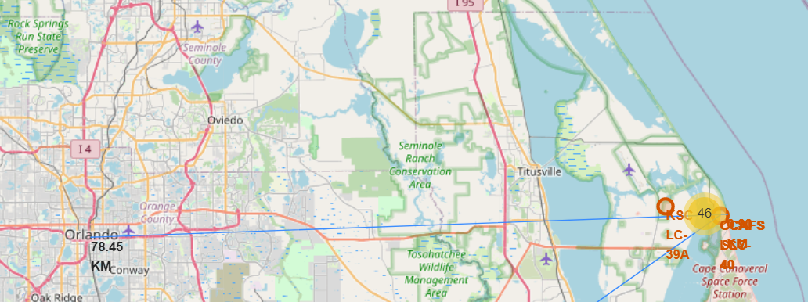
Launch Sites Distance to landmarks using CCAFS-SLC-40 as a reference
Distance to Coast Line
Distance to Florida City
Distance to closest High Way
Are launch sites in close proximity to railways? No
Are launch sites in close proximity to highways? No
Are launch sites in close proximity to coastline? Yes
Do launch sites keep certain distance away from cities? Yes

Slide 38

Section 4

Slide 39

Pie Chart Dashboard showing the success rate achieved by each Launch Site

Slide 40
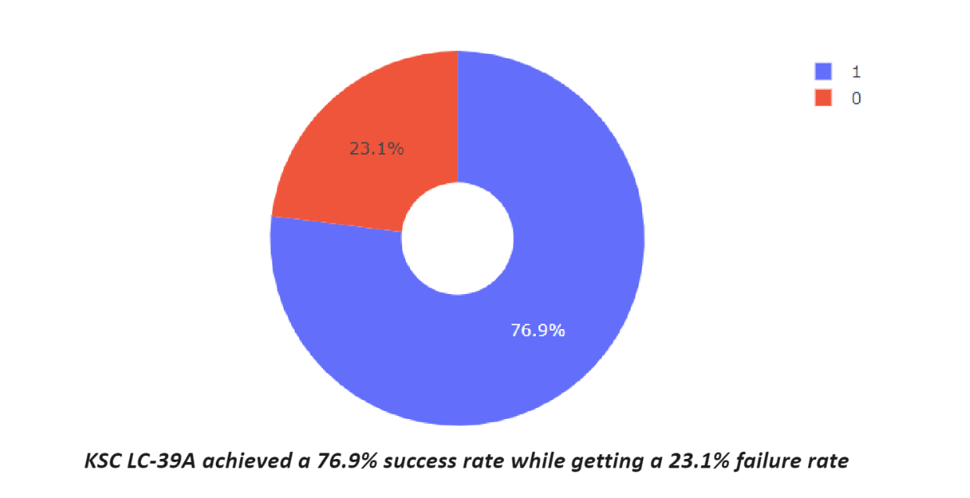
Pie Chart Dashboard for the Launch Site with highest launch success ratio

Slide 41
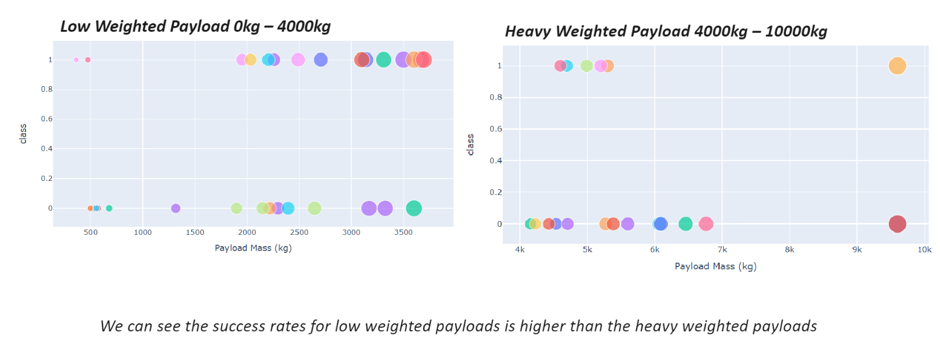
Scatter Plot Dashboard for Payload vs. Launch Outcome for all sites, with different payload selected in the range slider

Slide 42

Section 5

Slide 43
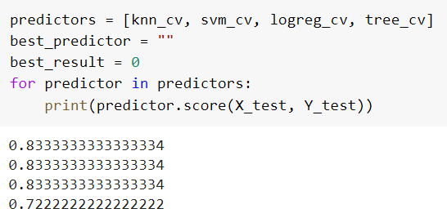
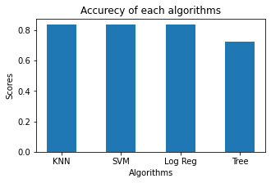
Classification Accuracy
As you can see the accuracy is extremely close so we choose SVM as our winner.
After selecting the best hyperparameters for the SVM classifier using the validation data, we achieved 83.33% accuracy on the test data.

Slide 44
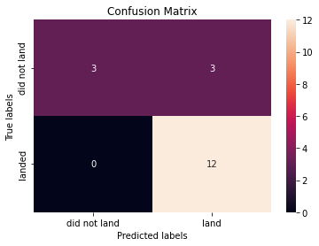
Confusion Matrix
Examining the confusion matrix, we see that Tree can distinguish between the different classes. We see that the major problem is false positives.

Slide 45
Conclusions
The Tree Classifier Algorithm is the best for Machine Learning for this dataset
Low weighted payloads perform better than the heavier payloads
The success rates for SpaceX launches is directly proportional time in years they will eventually perfect the launches
We can see that KSC LC-39A had the most successful launches from all the sites
Orbit GEO,HEO,SSO,ES-L1 has the best Success Rate

Slide 46
Appendix
Haversine Formula
Python Dashboard
SQL Queries
Machine Learning Prediction

Slide 47


